Slide 1

Chapter 1:
Introduction to Data Preprocessing
Notes:
‹#›

Slide 2
Introduction to Data Preprocessing
Objective
Data preprocessing is a fundamental step in data mining.
It involves cleaning, integration, transformation, and reduction of data.
Data preprocessing is essential for improving data quality and analysis outcomes.
This presentation will delve into each aspect of data preprocessing in detail.
‹#›

Slide 3
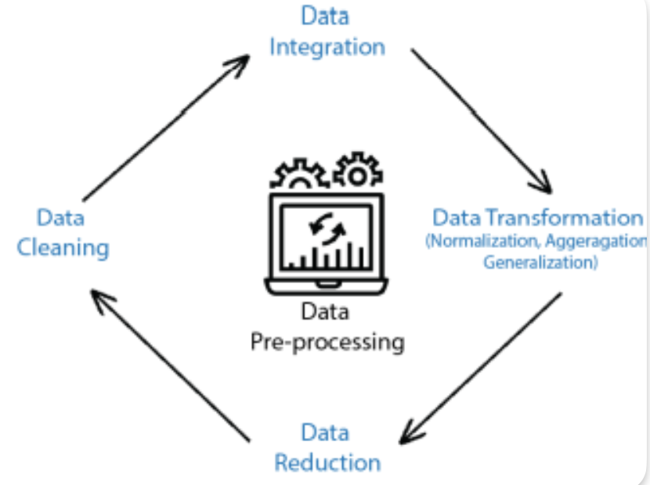
Introduction to Data Preprocessing
Data Preprocessing
The necessity of data preprocessing and techniques for achieving clean and usable data.
Data Preprocessing:
  Enhancing data quality and utility before analysis.
  Essential for accurate and meaningful results.
‹#›

Slide 4
Introduction to Data Preprocessing
Data Cleaning
Data cleaning involves identifying and rectifying errors and inconsistencies in the dataset.
Key Tasks:
  Handling missing values.
  Correcting inaccuracies.
  Handling duplicate records.
  Effective data cleaning improves data reliability.
‹#›

Slide 5
Introduction to Data Preprocessing
Data Integration
Data integration combines data from multiple sources into a unified format.
Challenges:
  Data format disparities.
  Data redundancy.
Benefits:
  Comprehensive analysis.
  Improved decision-making.
  Data integration streamlines data utilization.
‹#›

Slide 6
Introduction to Data Preprocessing
Data Transformation
Data transformation modifies the data format or structure to suit analysis requirements.
Normalization:
  Scales attributes to a standard range.
  Ensures equal importance to all attributes.
Attribute Construction:
  Creating new attributes from existing ones.
  Data transformation enhances analysis accuracy.
‹#›

Slide 7
Introduction to Data Preprocessing
Data Reduction
Data reduction minimizes data volume while preserving essential information.
Dimensionality Reduction:
  Reduces the number of attributes while retaining meaningful patterns.
Numerosity Reduction:
  Summarizes data by creating representative prototypes.
  Data reduction enhances analysis efficiency.
‹#›

Slide 8
Introduction to Data Preprocessing
Handling Missing Data
Dealing with missing data is a crucial aspect of data preprocessing.
Various strategies exist for addressing missing values.
Imputation methods, such as mean, median, and advanced techniques like K-Nearest Neighbors, are commonly used.
Effective handling of missing data ensures the completeness and accuracy of the dataset.
‹#›

Slide 9
Introduction to Data Preprocessing
Data Integration Techniques
Data integration involves combining data from multiple sources into a unified dataset.
Schema matching and mapping are crucial for resolving data structure differences.
Data fusion methods help consolidate information from various sources.
Resolving data conflicts ensures data consistency and accuracy in integrated datasets.
‹#›

Slide 10
Introduction to Data Preprocessing
Normalization and Scaling
Normalization and scaling are essential data transformation techniques.
Normalization adjusts data values to a common scale, often between 0 and 1.
Scaling techniques, such as Min-Max Scaling and Z-score normalization, make data comparable.
Proper scaling ensures that features have similar influence in data analysis and modeling.
‹#›

Slide 11
Introduction to Data Preprocessing
Encoding Categorical Data
Handling categorical data is a critical part of data preprocessing.
Categorical data includes non-numeric variables like labels or categories.
Common encoding methods include one-hot encoding and label encoding.
The choice of encoding method depends on the nature of the data and the modeling technique used.
‹#›

Slide 12
Introduction to Data Preprocessing
Feature Engineering
Feature engineering is the process of creating new features or modifying existing ones.
It aims to enhance the predictive power of the dataset.
Feature engineering involves domain knowledge and creativity.
Properly engineered features can improve model performance and uncover hidden patterns.
‹#›

Slide 13
Introduction to Data Preprocessing
Dimensionality Reduction
Dimensionality reduction is a critical data reduction technique.
It focuses on reducing the number of features while retaining essential information.
Common methods include Principal Component Analysis (PCA) and t-Distributed Stochastic Neighbor Embedding (t-SNE).
Dimensionality reduction enhances efficiency, visualization, and model performance.
‹#›

Slide 14
Introduction to Data Preprocessing
Feature Selection
Feature selection is the process of choosing the most relevant features for analysis.
It reduces dimensionality by eliminating irrelevant or redundant attributes.
Methods include filter, wrapper, and embedded approaches.
Proper feature selection improves model interpretability and efficiency.
‹#›

Slide 15
Introduction to Data Preprocessing
Benefits of Data Preprocessing
Data preprocessing offers several advantages:
Improved Model Performance
Reduced Overfitting
Enhanced Interpretability
Savings in Time and Resources
Effective preprocessing is key to achieving high-quality results in data analysis and modeling.
‹#›

Slide 16
Introduction to Data Preprocessing
Summary
Data Preprocessing Steps: Data Cleaning, Integration, Transformation, Reduction
Role of each step in High-Quality Data Analysis
‹#›

